Slide 1
Convolutional Neural Network

Slide 2
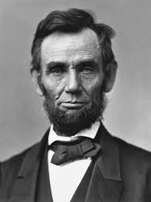
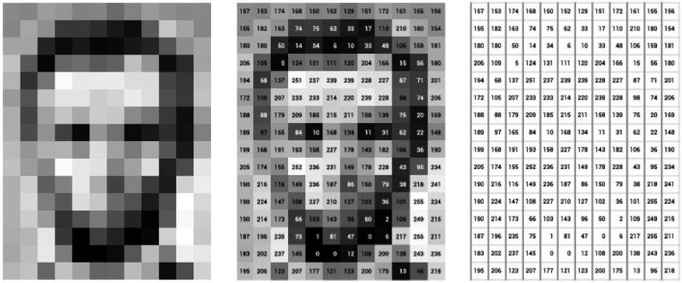
Image are Numbers
What we see!

Slide 3
Image are Numbers
What we see!
What computers see!

Slide 4
Image are Numbers
An image is just a matrix of numbers

Slide 5


Let us use an easier example like the letter O and X

Slide 6
If we zoom in on the letter O and letter X, we can see that each of them are only made of a bunch of pixels.

Slide 7
0 | 0 | 1 | 1 | 0 | 0
0 | 11 | 0 | 0 | 1 | 0
1 | 0 | 0 | 0 | 0 | 1
1 | 0 | 0 | 0 | 0 | 1
0 | 1 | 0 | 0 | 1 | 0
0 | 0 | 1 | 1 | 0 | 0
1 | 0 | 0 | 0 | 0 | 1
0 | 1 | 0 | 0 | 1 | 0
0 | 0 | 1 | 1 | 0 | 0
0 | 0 | 1 | 1 | 0 | 0
0 | 1 | 0 | 0 | 1 | 0
1 | 0 | 0 | 0 | 0 | 1
Each pixel is represented by either a 0 for a white pixel and 1 for a black pixel

Slide 8
0 | 0 | 1 | 1 | 0 | 0
0 | 11 | 0 | 0 | 1 | 0
1 | 0 | 0 | 0 | 0 | 1
1 | 0 | 0 | 0 | 0 | 1
0 | 1 | 0 | 0 | 1 | 0
0 | 0 | 1 | 1 | 0 | 0
1 | 0 | 0 | 0 | 0 | 1
0 | 1 | 0 | 0 | 1 | 0
0 | 0 | 1 | 1 | 0 | 0
0 | 0 | 1 | 1 | 0 | 0
0 | 1 | 0 | 0 | 1 | 0
1 | 0 | 0 | 0 | 0 | 1
Let us walk through step by step on how a computer can classify an image if it is a letter O or a letter X

Slide 9
6
0 | 0 | 1 | 1 | 0 | 0
0 | 11 | 0 | 0 | 1 | 0
1 | 0 | 0 | 0 | 0 | 1
1 | 0 | 0 | 0 | 0 | 1
0 | 1 | 0 | 0 | 1 | 0
0 | 0 | 1 | 1 | 0 | 0
6
Because this image is small with just 6 pixels by 6 pixels

Slide 10
6
0 | 0 | 1 | 1 | 0 | 0
0 | 11 | 0 | 0 | 1 | 0
1 | 0 | 0 | 0 | 0 | 1
1 | 0 | 0 | 0 | 0 | 1
0 | 1 | 0 | 0 | 1 | 0
0 | 0 | 1 | 1 | 0 | 0
6
It is possible to create a simple neural network that can correctly classify it.

Slide 11
0 | 0 | 1 | 1 | 0 | 0
0 | 11 | 0 | 0 | 1 | 0
1 | 0 | 0 | 0 | 0 | 1
1 | 0 | 0 | 0 | 0 | 1
0 | 1 | 0 | 0 | 1 | 0
0 | 0 | 1 | 1 | 0 | 0
We simply convert this grid of 6x6 pixels into a single column of 36 input nodes

Slide 12
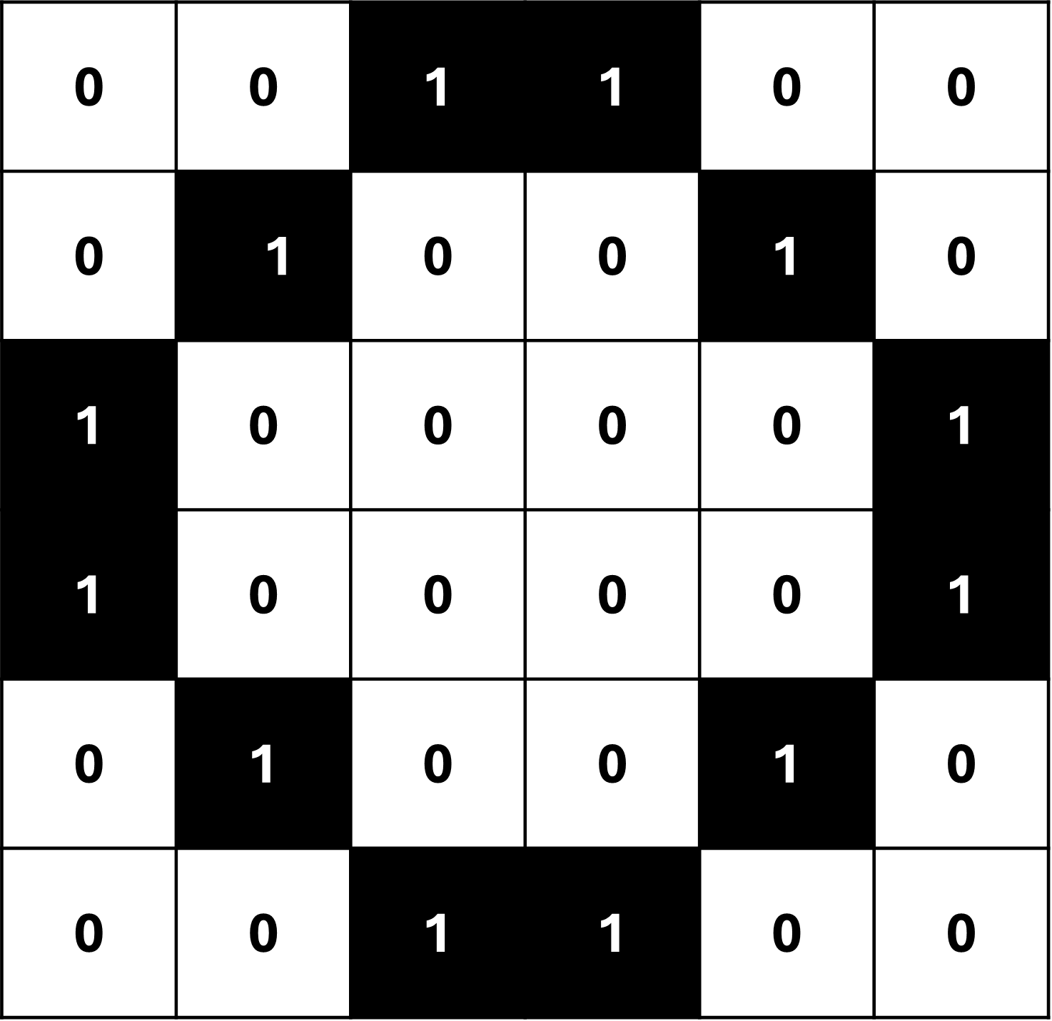


$$h_{1}$$
$$p_{i}$$
So we have 36 connections from the input node to the hidden layer

Slide 13
$$h_{1}$$
$$p_{i}$$
That means we have 36 weights to optimize with backpropagation.

Slide 14
$$h_{1}$$
$$p_{i}$$
Because this image is only small (6x6) and black and white, something like this could work.

Slide 15
$$h_{1}$$
$$p_{i}$$
However, if we had a larger image like 100x100 pixels which is still small compared to real world pictures

Slide 16
$$h_{1}$$
$$p_{i}$$
Then we would end up with 10,000 weights that we need to optimize per node in the hidden layer

Slide 17

$$h_{1}$$
$$p_{i}$$
So this method does not scale very well.

Slide 18
Thus, classification of large and complicated images is usually done using somethind called a Convolutional Neural Network

Slide 19
Input Image
0 | 0 | 1 | 1 | 0 | 0
0 | 11 | 0 | 0 | 1 | 0
1 | 0 | 0 | 0 | 0 | 1
1 | 0 | 0 | 0 | 0 | 1
0 | 1 | 0 | 0 | 1 | 0
0 | 0 | 1 | 1 | 0 | 0
Filter (aka Kernel)
0 | 0 | 1
0 | 1 | 0
1 | 0 | 0
The first thing a Convolutional Neural Network does is apply a Filter to the Input image

Slide 20
Input Image
0 | 0 | 1 | 1 | 0 | 0
0 | 11 | 0 | 0 | 1 | 0
1 | 0 | 0 | 0 | 0 | 1
1 | 0 | 0 | 0 | 0 | 1
0 | 1 | 0 | 0 | 1 | 0
0 | 0 | 1 | 1 | 0 | 0
Filter (aka Kernel)
0 | 0 | 1
0 | 1 | 0
1 | 0 | 0
In Convolutional Neural Networks, a Filter is a smaller square that is commonly 3 pixels by 3 pixels

Slide 21
Input Image
0 | 0 | 1 | 1 | 0 | 0
0 | 11 | 0 | 0 | 1 | 0
1 | 0 | 0 | 0 | 0 | 1
1 | 0 | 0 | 0 | 0 | 1
0 | 1 | 0 | 0 | 1 | 0
0 | 0 | 1 | 1 | 0 | 0
Filter (aka Kernel)
0 | 0 | 1
0 | 0 | 0
0 | 0 | 0
And the pixel values of the Filter start with random values when training a Convolutional Neural Network

Slide 22
Input Image
0 | 0 | 1 | 1 | 0 | 0
0 | 11 | 0 | 0 | 1 | 0
1 | 0 | 0 | 0 | 0 | 1
1 | 0 | 0 | 0 | 0 | 1
0 | 1 | 0 | 0 | 1 | 0
0 | 0 | 1 | 1 | 0 | 0
Filter (aka Kernel)
0 | 0 | 1
0 | 1 | 0
1 | 0 | 0
And after training with backpropagation, we end up with something more useful.

Slide 23
Input Image
0 | 0 | 1 | 1 | 0 | 0
0 | 11 | 0 | 0 | 1 | 0
1 | 0 | 0 | 0 | 0 | 1
1 | 0 | 0 | 0 | 0 | 1
0 | 1 | 0 | 0 | 1 | 0
0 | 0 | 1 | 1 | 0 | 0
Filter (aka Kernel)
0 | 0 | 1
0 | 1 | 0
1 | 0 | 0
To apply the Filter to the image, we overlay the Filter onto the image.

Slide 24
Input Image
0 | 0 | 1 | 1 | 0 | 0
0 | 11 | 0 | 0 | 1 | 0
1 | 0 | 0 | 0 | 0 | 1
1 | 0 | 0 | 0 | 0 | 1
0 | 1 | 0 | 0 | 1 | 0
0 | 0 | 1 | 1 | 0 | 0
Filter (aka Kernel)
0 | 0 | 1
0 | 1 | 0
1 | 0 | 0
And then we multiply together each overlapping pixel.

Slide 25

Input Image
0 | 0 | 1 | 1 | 0 | 0
0 | 11 | 0 | 0 | 1 | 0
1 | 0 | 0 | 0 | 0 | 1
1 | 0 | 0 | 0 | 0 | 1
0 | 1 | 0 | 0 | 1 | 0
0 | 0 | 1 | 1 | 0 | 0
Filter (aka Kernel)
0 | 0 | 1
0 | 1 | 0
1 | 0 | 0
$$(0×0)$$

Slide 26

Input Image
0 | 0 | 1 | 1 | 0 | 0
0 | 11 | 0 | 0 | 1 | 0
1 | 0 | 0 | 0 | 0 | 1
1 | 0 | 0 | 0 | 0 | 1
0 | 1 | 0 | 0 | 1 | 0
0 | 0 | 1 | 1 | 0 | 0
Filter (aka Kernel)
0 | 0 | 1
0 | 1 | 0
1 | 0 | 0
$$(0×0)$$
$$(0×0)$$

Slide 27

Input Image
0 | 0 | 1 | 1 | 0 | 0
0 | 11 | 0 | 0 | 1 | 0
1 | 0 | 0 | 0 | 0 | 1
1 | 0 | 0 | 0 | 0 | 1
0 | 1 | 0 | 0 | 1 | 0
0 | 0 | 1 | 1 | 0 | 0
Filter (aka Kernel)
0 | 0 | 1
0 | 1 | 0
1 | 0 | 0
$$(0×0)$$
$$(0×0)$$
$$(1×1)$$

Slide 28

Input Image
0 | 0 | 1 | 1 | 0 | 0
0 | 11 | 0 | 0 | 1 | 0
1 | 0 | 0 | 0 | 0 | 1
1 | 0 | 0 | 0 | 0 | 1
0 | 1 | 0 | 0 | 1 | 0
0 | 0 | 1 | 1 | 0 | 0
Filter (aka Kernel)
0 | 0 | 1
0 | 1 | 0
1 | 0 | 0
$$(0×0)$$
$$(0×0)$$
$$(1×1)$$
$$(0×0)$$

Slide 29

Input Image
0 | 0 | 1 | 1 | 0 | 0
0 | 11 | 0 | 0 | 1 | 0
1 | 0 | 0 | 0 | 0 | 1
1 | 0 | 0 | 0 | 0 | 1
0 | 1 | 0 | 0 | 1 | 0
0 | 0 | 1 | 1 | 0 | 0
Filter (aka Kernel)
0 | 0 | 1
0 | 1 | 0
1 | 0 | 0
$$(0×0)$$
$$(0×0)$$
$$(1×1)$$
$$(0×0)$$
$$(1×1)$$

Slide 30

Input Image
0 | 0 | 1 | 1 | 0 | 0
0 | 11 | 0 | 0 | 1 | 0
1 | 0 | 0 | 0 | 0 | 1
1 | 0 | 0 | 0 | 0 | 1
0 | 1 | 0 | 0 | 1 | 0
0 | 0 | 1 | 1 | 0 | 0
Filter (aka Kernel)
0 | 0 | 1
0 | 1 | 0
1 | 0 | 0
$$(0×0)$$
$$(0×0)$$
$$(1×1)$$
$$(0×0)$$
$$(1×1)$$
$$(0×0)$$

Slide 31

Input Image
0 | 0 | 1 | 1 | 0 | 0
0 | 11 | 0 | 0 | 1 | 0
1 | 0 | 0 | 0 | 0 | 1
1 | 0 | 0 | 0 | 0 | 1
0 | 1 | 0 | 0 | 1 | 0
0 | 0 | 1 | 1 | 0 | 0
Filter (aka Kernel)
0 | 0 | 1
0 | 1 | 0
1 | 0 | 0
$$(0×0)$$
$$(0×0)$$
$$(1×1)$$
$$(0×0)$$
$$(1×1)$$
$$(0×0)$$
$$(1×1)$$

Slide 32

Input Image
0 | 0 | 1 | 1 | 0 | 0
0 | 11 | 0 | 0 | 1 | 0
1 | 0 | 0 | 0 | 0 | 1
1 | 0 | 0 | 0 | 0 | 1
0 | 1 | 0 | 0 | 1 | 0
0 | 0 | 1 | 1 | 0 | 0
Filter (aka Kernel)
0 | 0 | 1
0 | 1 | 0
1 | 0 | 0
$$(0×0)$$
$$(0×0)$$
$$(1×1)$$
$$(0×0)$$
$$(1×1)$$
$$(0×0)$$
$$(1×1)$$
$$(0×0)$$

Slide 33

Input Image
0 | 0 | 1 | 1 | 0 | 0
0 | 11 | 0 | 0 | 1 | 0
1 | 0 | 0 | 0 | 0 | 1
1 | 0 | 0 | 0 | 0 | 1
0 | 1 | 0 | 0 | 1 | 0
0 | 0 | 1 | 1 | 0 | 0
Filter (aka Kernel)
0 | 0 | 1
0 | 1 | 0
1 | 0 | 0
$$(0×0)$$
$$(0×0)$$
$$(1×1)$$
$$(0×0)$$
$$(1×1)$$
$$(0×0)$$
$$(1×1)$$
$$(0×0)$$
$$(0×0)$$

Slide 34
Input Image
0 | 0 | 1 | 1 | 0 | 0
0 | 11 | 0 | 0 | 1 | 0
1 | 0 | 0 | 0 | 0 | 1
1 | 0 | 0 | 0 | 0 | 1
0 | 1 | 0 | 0 | 1 | 0
0 | 0 | 1 | 1 | 0 | 0
Filter (aka Kernel)
0 | 0 | 1
0 | 1 | 0
1 | 0 | 0
$$(0×0)$$
$$(0×0)$$
$$(1×1)$$
$$(0×0)$$
$$(1×1)$$
$$(0×0)$$
And then we add each product
together …
$$(1×1)$$
$$(0×0)$$
$$(0×0)$$

Slide 35

Input Image
0 | 0 | 1 | 1 | 0 | 0
0 | 11 | 0 | 0 | 1 | 0
1 | 0 | 0 | 0 | 0 | 1
1 | 0 | 0 | 0 | 0 | 1
0 | 1 | 0 | 0 | 1 | 0
0 | 0 | 1 | 1 | 0 | 0
Filter (aka Kernel)
0 | 0 | 1
0 | 1 | 0
1 | 0 | 0
$$(0×0)$$
$$(0×0)$$
$$(1×1)$$
$$(0×0)$$
$$(1×1)$$
$$(0×0)$$
To get the dot product which in this case is 3
$$(1×1)$$
$$(0×0)$$
$$(0×0)$$
$$=3$$

Slide 36
Input Image
0 | 0 | 1 | 1 | 0 | 0
0 | 11 | 0 | 0 | 1 | 0
1 | 0 | 0 | 0 | 0 | 1
1 | 0 | 0 | 0 | 0 | 1
0 | 1 | 0 | 0 | 1 | 0
0 | 0 | 1 | 1 | 0 | 0
Filter (aka Kernel)
0 | 0 | 1
0 | 1 | 0
1 | 0 | 0
$$(0×0)$$
$$(0×0)$$
$$(1×1)$$
$$(0×0)$$
$$(1×1)$$
$$(0×0)$$
By computing the Dot Product between the input and the filter, we can say that the Filter is Convolved with the input.
$$(1×1)$$
$$(0×0)$$
$$(0×0)$$
$$=3$$

Slide 37
Input Image
0 | 0 | 1 | 1 | 0 | 0
0 | 11 | 0 | 0 | 1 | 0
1 | 0 | 0 | 0 | 0 | 1
1 | 0 | 0 | 0 | 0 | 1
0 | 1 | 0 | 0 | 1 | 0
0 | 0 | 1 | 1 | 0 | 0
Filter (aka Kernel)
0 | 0 | 1
0 | 1 | 0
1 | 0 | 0
$$(0×0)$$
$$(0×0)$$
$$(1×1)$$
$$(0×0)$$
$$(1×1)$$
$$(0×0)$$
And that is what gives Convolutional
Neural Network their name
$$(1×1)$$
$$(0×0)$$
$$(0×0)$$
$$=3$$

Slide 38
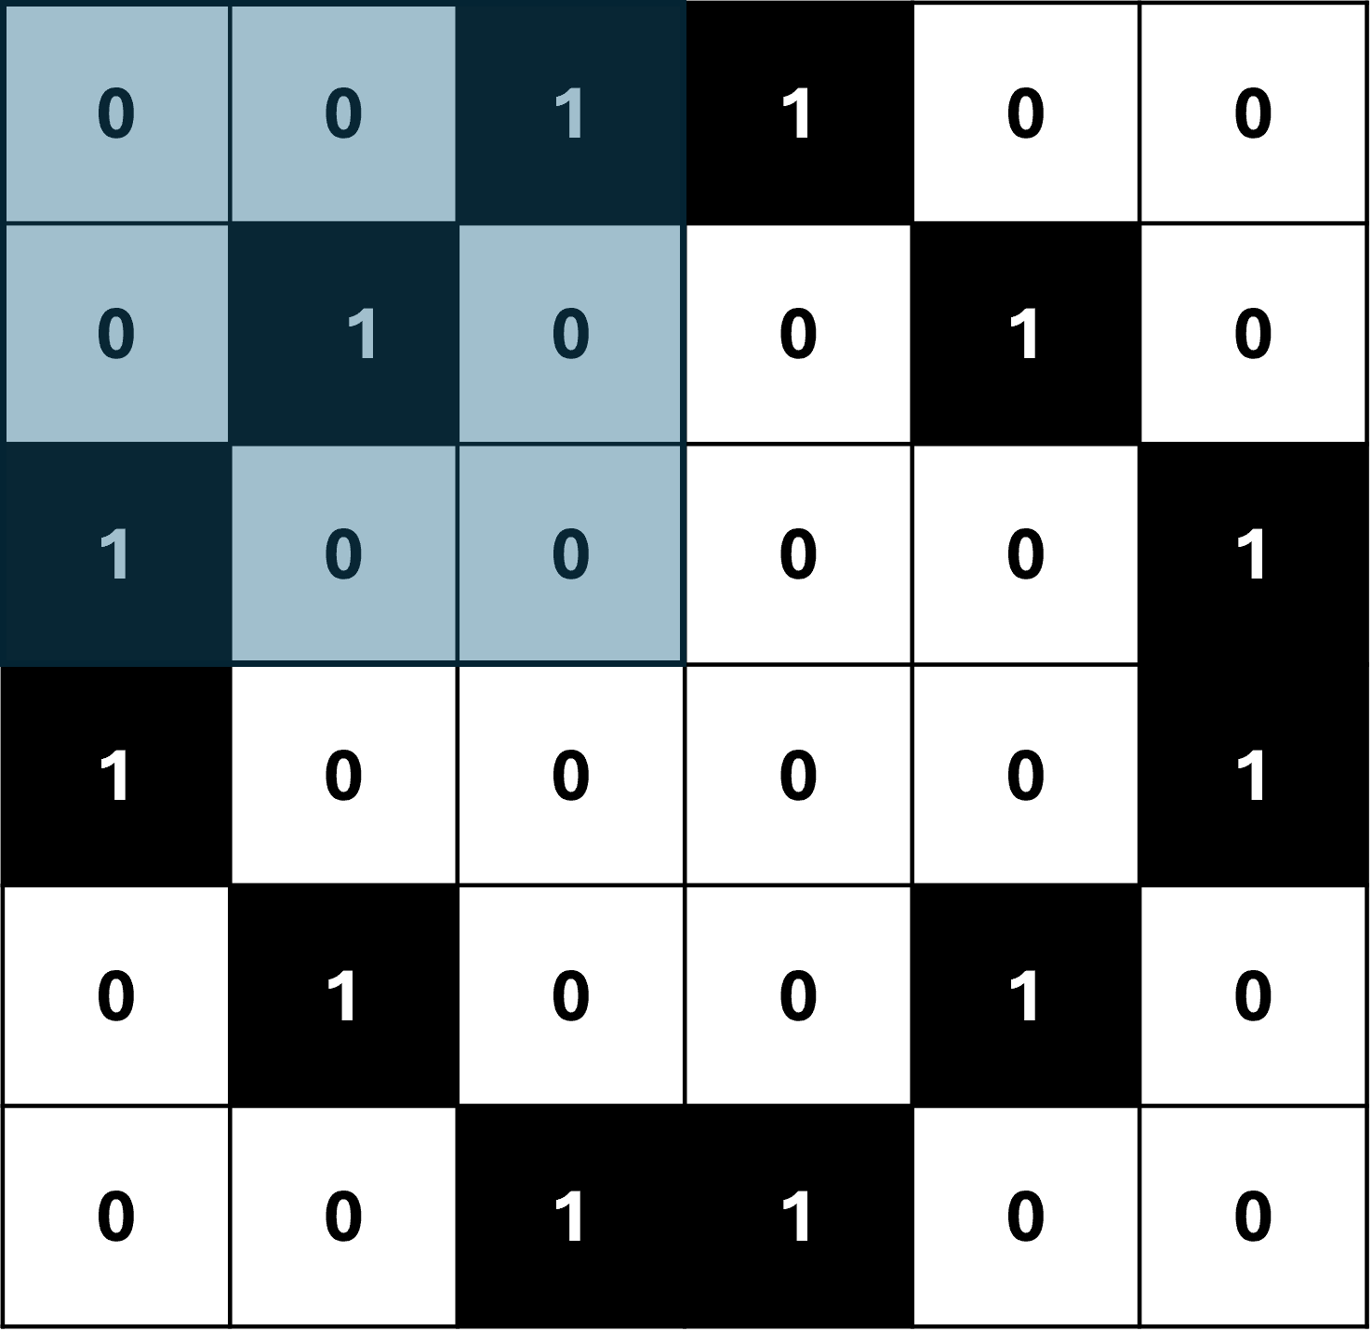
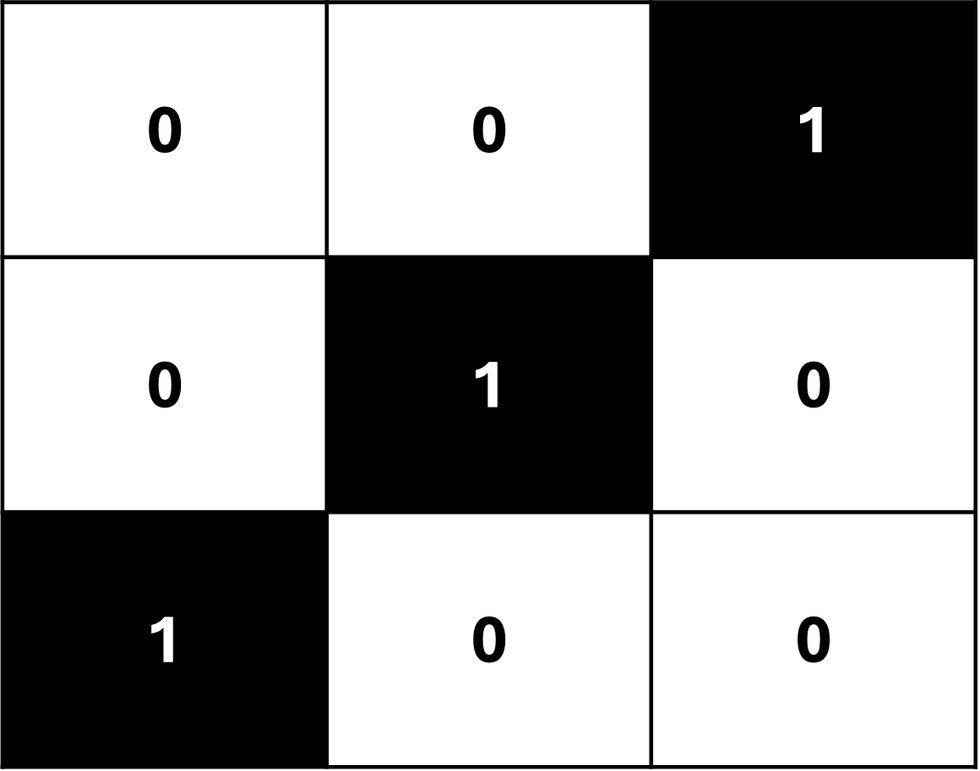










Now we add a Bias term to the output of the Filter
Input Image
Filter (aka Kernel)
+ (-2)
$$(0×0)$$
$$(0×0)$$
$$(1×1)$$
$$(0×0)$$
$$(1×1)$$
$$(0×0)$$
$$(1×1)$$
$$(0×0)$$
$$(0×0)$$
$$=3$$

Slide 39
And put the final value into something called a Feature Map
Input Image
Filter (aka Kernel)
Feature Map
1
+ (-2)
$$(0×0)$$
$$(0×0)$$
$$(1×1)$$
$$(0×0)$$
$$(1×1)$$
$$(0×0)$$
$$(1×1)$$
$$(0×0)$$
$$(0×0)$$
$$=3$$

Slide 40
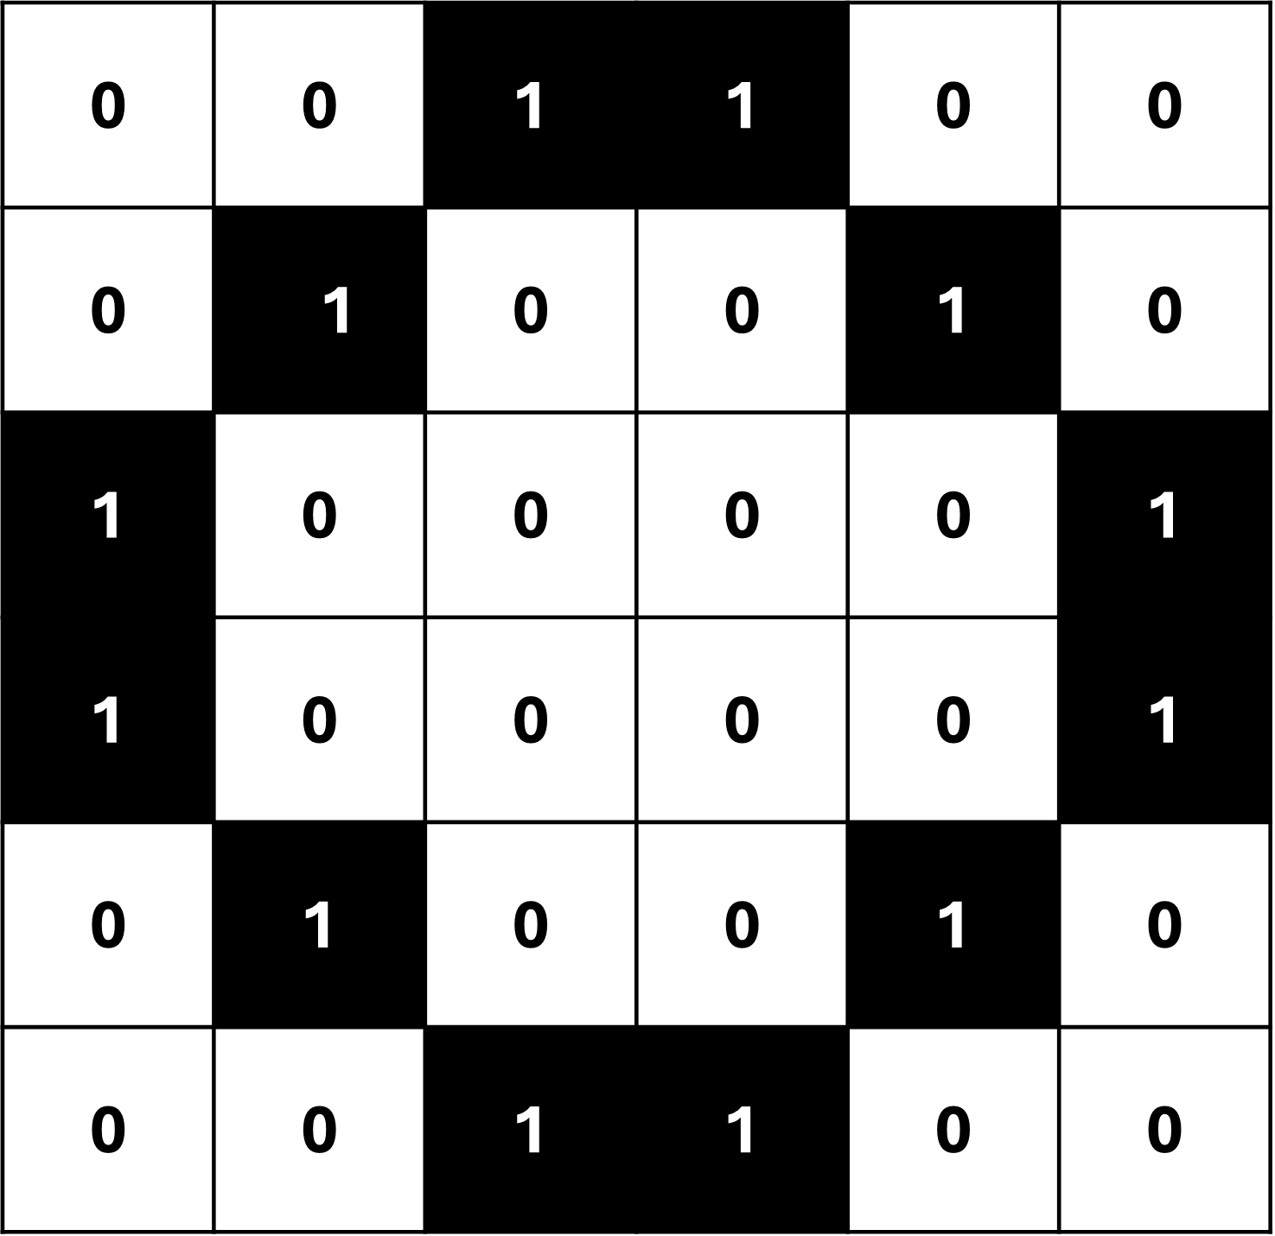
Next we slide the Filter over one pixel to the right.
Input Image
Filter (aka Kernel)
Feature Map
1
+ (-2)

Slide 41
Other Convolutional Neural Networks might move 2 or more pixels. But in our example, we move it by 1
Input Image
Filter (aka Kernel)
Feature Map
1
+ (-2)

Slide 42
We calculate the Dot Product of the Filter and add the Bias Term
Input Image
Filter (aka Kernel)
Feature Map
1
+ (-2)

Slide 43
And put the final value into the Feature Map
Input Image
Filter (aka Kernel)
Feature Map
1 | -1
+ (-2)

Slide 44
Then we shift the Filter again and repeat until we have filled up the Feature Map
Input Image
Filter (aka Kernel)
Feature Map
1 | -1 | -2
+ (-2)

Slide 45
Then we shift the Filter again and repeat until we have filled up the Feature Map
Input Image
Filter (aka Kernel)
Feature Map
1 | -1 | -2 | -1
+ (-2)

Slide 46
Then we shift the Filter again and repeat until we have filled up the Feature Map
Input Image
Filter (aka Kernel)
Feature Map
1 | -1 | -2 | -1
-1
+ (-2)

Slide 47
Then we shift the Filter again and repeat until we have filled up the Feature Map
Input Image
Filter (aka Kernel)
Feature Map
1 | -1 | -2 | -1
-1 | -2
+ (-2)

Slide 48
Then we shift the Filter again and repeat until we have filled up the Feature Map
Input Image
Filter (aka Kernel)
Feature Map
1 | -1 | -2 | -1
-1 | -2 | -1
+ (-2)

Slide 49
Then we shift the Filter again and repeat until we have filled up the Feature Map
Input Image
Filter (aka Kernel)
Feature Map
1 | -1 | -2 | -1
-1 | -2 | -1 | -2
+ (-2)

Slide 50
Then we shift the Filter again and repeat until we have filled up the Feature Map
Input Image
Filter (aka Kernel)
Feature Map
1 | -1 | -2 | -1
-1 | -2 | -1 | -2
-2
+ (-2)

Slide 51
Then we shift the Filter again and repeat until we have filled up the Feature Map
Input Image
Filter (aka Kernel)
Feature Map
1 | -1 | -2 | -1
-1 | -2 | -1 | -2
-2 | -1
+ (-2)

Slide 52
Then we shift the Filter again and repeat until we have filled up the Feature Map
Input Image
Filter (aka Kernel)
Feature Map
1 | -1 | -2 | -1
-1 | -2 | -1 | -2
-2 | -1 | -2
+ (-2)

Slide 53
Then we shift the Filter again and repeat until we have filled up the Feature Map
Input Image
Filter (aka Kernel)
Feature Map
1 | -1 | -2 | -1
-1 | -2 | -1 | -2
-2 | -1 | -2 | -1
+ (-2)

Slide 54
Then we shift the Filter again and repeat until we have filled up the Feature Map
Input Image
Filter (aka Kernel)
Feature Map
1 | -1 | -2 | -1
-1 | -2 | -1 | -2
-2 | -1 | -2 | -1
-1
+ (-2)

Slide 55
Then we shift the Filter again and repeat until we have filled up the Feature Map
Input Image
Filter (aka Kernel)
Feature Map
1 | -1 | -2 | -1
-1 | -2 | -1 | -2
-2 | -1 | -2 | -1
-1 | -2
+ (-2)

Slide 56
Then we shift the Filter again and repeat until we have filled up the Feature Map
Input Image
Filter (aka Kernel)
Feature Map
1 | -1 | -2 | -1
-1 | -2 | -1 | -2
-2 | -1 | -2 | -1
-1 | -2 | -1
+ (-2)

Slide 57
Then we shift the Filter again and repeat until we have filled up the Feature Map
Input Image
Filter (aka Kernel)
Feature Map
1 | -1 | -2 | -1
-1 | -2 | -1 | -2
-2 | -1 | -2 | -1
-1 | -2 | -1 | 1
+ (-2)

Slide 58
Feature Map
Feature Map, Post ReLu
1 | -1 | -2 | -1
-1 | -2 | -1 | -2
-2 | -1 | -2 | -1
-1 | -2 | -1 | 1
1 | 0 | 0 | 0
0 | 0 | 0 | 0
0 | 0 | 0 | 0
0 | 0 | 0 | 1
ReLU
Next, we run the Feature map through a ReLU activation function

Slide 59
Feature Map
Feature Map, Post ReLu
1 | -1 | -2 | -1
-1 | -2 | -1 | -2
-2 | -1 | -2 | -1
-1 | -2 | -1 | 1
1 | 0 | 0 | 0
0 | 0 | 0 | 0
0 | 0 | 0 | 0
0 | 0 | 0 | 1
ReLU
And that means that all negative values will be set to 0 and the positive values will remain the same

Slide 60
Feature Map, Post ReLu
1 | 0 | 0 | 0
0 | 0 | 0 | 0
0 | 0 | 0 | 0
0 | 0 | 0 | 1
1
Now we apply another filter to the new feature map

Slide 61
Feature Map, Post ReLu
1 | 0 | 0 | 0
0 | 0 | 0 | 0
0 | 0 | 0 | 0
0 | 0 | 0 | 1
1
Unlike before, we simply select the maximum value

Slide 62
Feature Map, Post ReLu
1 | 0 | 0 | 0
0 | 0 | 0 | 0
0 | 0 | 0 | 0
0 | 0 | 0 | 1
1 | 0
And this filter moves in such a way that it does not overlap itself

Slide 63
Feature Map, Post ReLu
1 | 0 | 0 | 0
0 | 0 | 0 | 0
0 | 0 | 0 | 0
0 | 0 | 0 | 1
1 | 0
0
And this filter moves in such a way that it does not overlap itself

Slide 64
Feature Map, Post ReLu
1 | 0 | 0 | 0
0 | 0 | 0 | 0
0 | 0 | 0 | 0
0 | 0 | 0 | 1
1 | 0
0 | 1
And this filter moves in such a way that it does not overlap itself

Slide 65
Feature Map, Post ReLu
1 | 0 | 0 | 0
0 | 0 | 0 | 0
0 | 0 | 0 | 0
0 | 0 | 0 | 1
Max Pooled
1 | 0
0 | 1
When we select the maximum value in each region, we are applying max pooling

Slide 66
1
0
0
1
Max Pooled
1 | 0
0 | 1
The max pooled values are then converted into a column

Slide 67















1
0
0
1
1
$$b$$
$$1.45$$
$$−0.8$$
$$h_{1}$$
$$b$$
Max Pooled
$$−1.33$$
0
$$−0.07$$
$$0.97$$
1 | 0
0 | 1
ReLU
$$z_{1}$$
0
$$0.2$$
$$0.17$$
$$h_{2}$$
$$1.33$$
1
$$b$$
$$−0.45$$
These values will then be used as input into a neural network that will classify the image if it is an O or X

Slide 68
1
0
0
1
1
$$b$$
$$1.45$$
$$−0.8$$
$$h_{1}$$
1
$$b$$
Max Pooled
$$−1.33$$
0
$$−0.07$$
$$0.97$$
1 | 0
0 | 1
ReLU
$$z_{1}$$
0
$$0.2$$
$$0.17$$
$$1.33$$
0
1
$$h_{2}$$
$$b$$
$$−0.45$$
These values will then be used as input into a neural network that will classify the image if it is an O or X

Slide 69
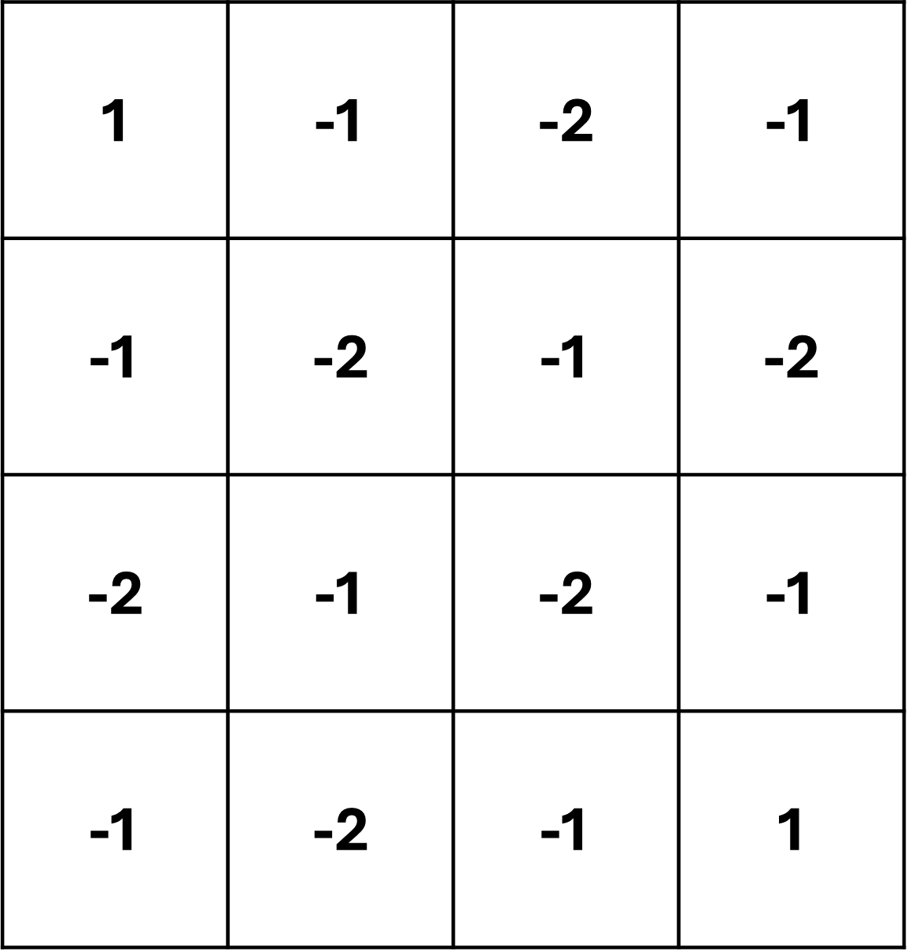
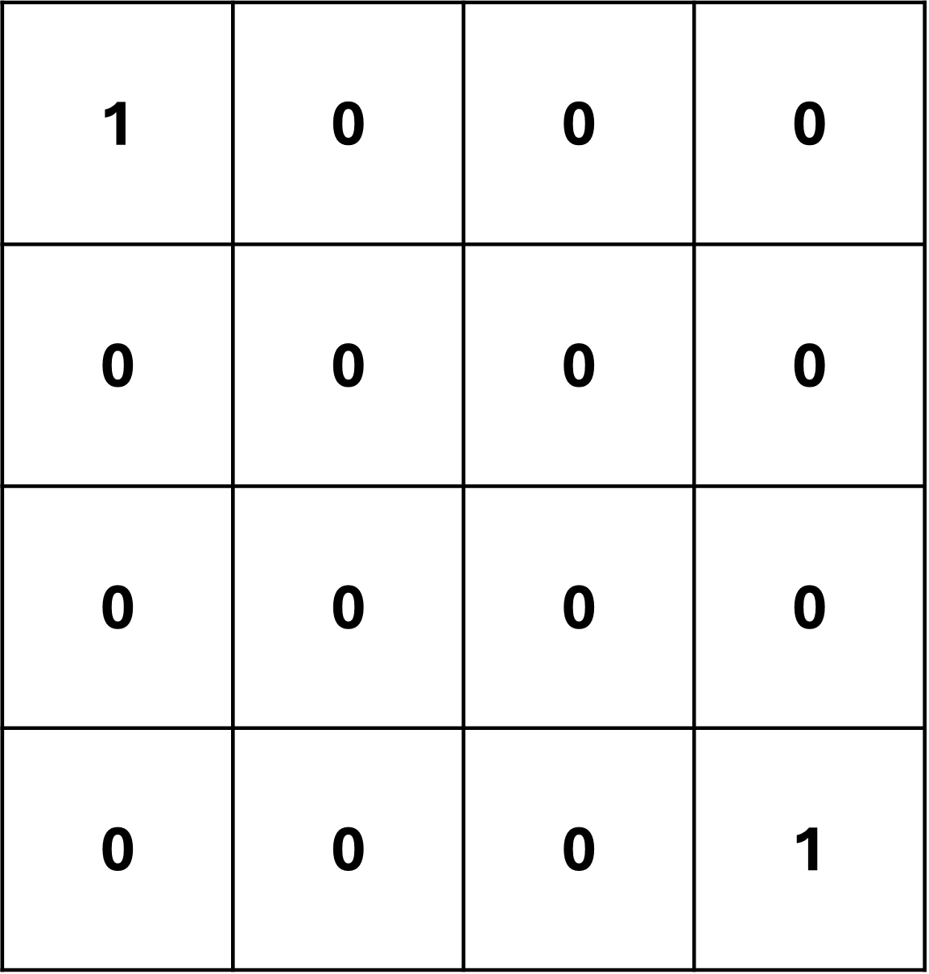
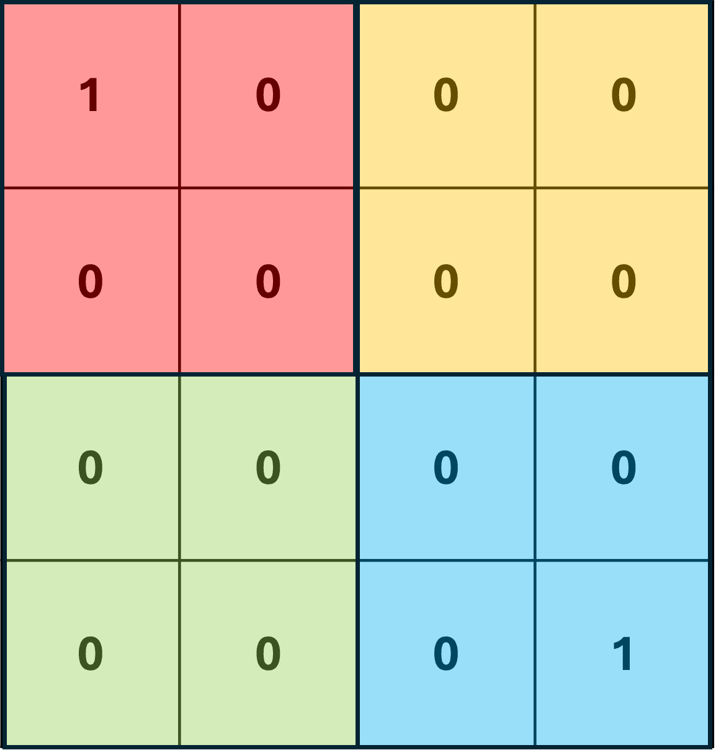
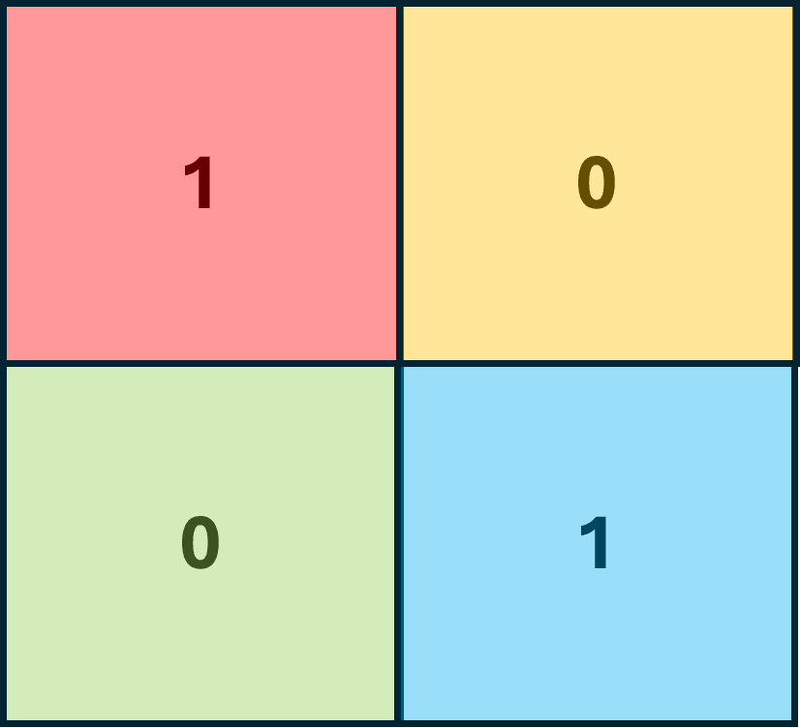
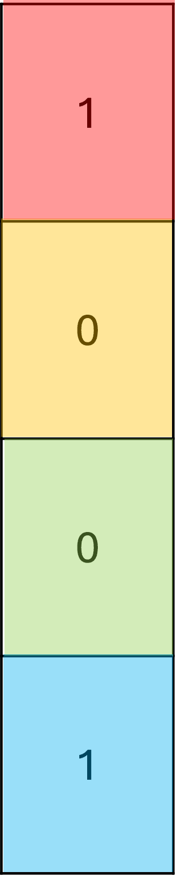
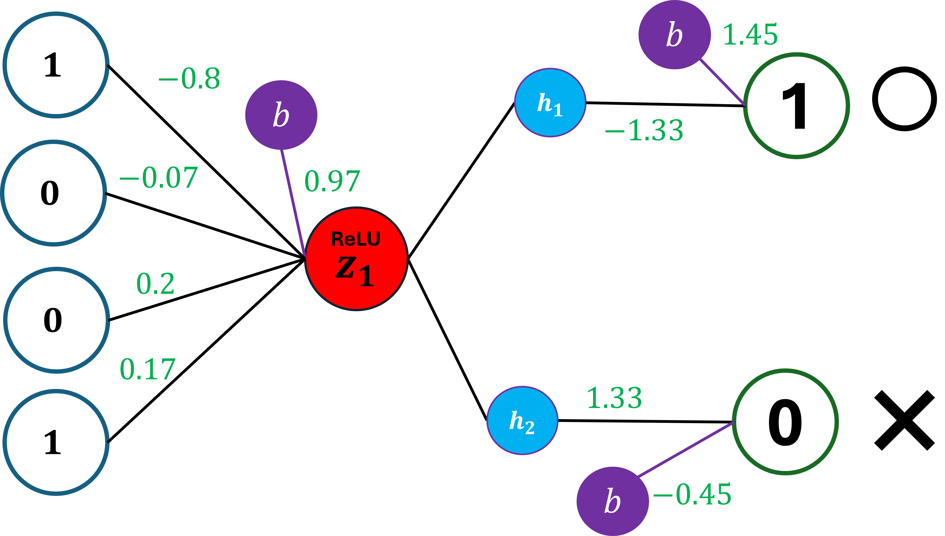
Feature Map
Feature Map (After ReLU)
Apply Max Pooling
Max Pooled
ReLU
+ (-2)
Apply Filter
Convert to Column
Plug into input layer
Input Image

Slide 70
0
0
1
1
0
0
0
1
0
0
1
0
1
0
0
0
0
1
1
0
0
0
0
1
0
1
0
0
1
0
0
0
1
1
0
0
0 | 0 | 1 | 1 | 0 | 0
0 | 11 | 0 | 0 | 1 | 0
1 | 0 | 0 | 0 | 0 | 1
1 | 0 | 0 | 0 | 0 | 1
0 | 1 | 0 | 0 | 1 | 0
0 | 0 | 1 | 1 | 0 | 0
It is possible to create a simple neural network that can correctly classify it.

